Slide 1
Emerging Technologies in Teaching and Learning (AI)
Presenter: Nkosinathi Hlongwane

Slide 2
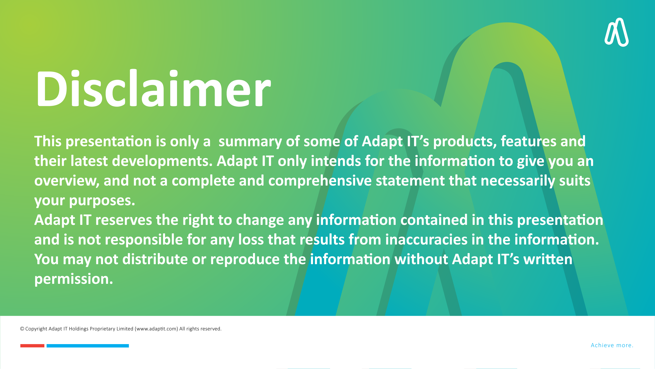

DISCLAIMER
This presentation is only a summary of some of Adapt IT’s products, features and their latest developments. Adapt IT only intends for the information to give you an overview, and not a complete and comprehensive statement that necessarily suits your purposes.
Adapt IT reserves the right to change any information contained in this presentation and is not responsible for any loss that results from inaccuracies in the information. You may not distribute or reproduce the information without Adapt IT’s written permission.

Slide 3

Emerging Technologies in Teaching and Learning
What is Artificial Intelligence?
Artificial Intelligence in Moodle 4.5
Key Components of AI Sub-system in Moodle
Benefits of Artificial Intelligence in Moodle
Demonstration
Table of contents

Slide 4
Emerging Technologies in Teaching and Learning

Slide 5




Emerging Technologies In Teaching And Learning
Gamification
Virtual Reality (VR)
Learning Analytics
Artificial Intelligence (AI)
  Use of leaderboards, badges, and challenges to increase engagement.
  Serious games for skill-building and problem-solving
  Immersive simulations for hands-on learning experiences.
  Virtual field trips and labs for STEM education.
  Predictive analytics to identify at-risk students.
  Personalised learning pathways based on performance data
  AI-powered chatbots and virtual tutors for personalised learning.
  Automated grading and feedback systems.

Slide 6
What is Artificial Intelligence?

Slide 7

What Is Artificial Intelligence?
?

Slide 8

What Is Artificial Intelligence?
https://youtu.be/7z56yJFlGlc?si=wZ1QD99tzCzzW2W6
Notes:
Imagine you walk into a supermarket, and as you approach the checkout, there’s no cashier. Instead, you see a machine that scans your items, calculates the total, and lets you pay without needing any human assistance. Even more, the system suggests discounts based on what you frequently buy.
Now, I want to ask you:
1. Do you think this is Artificial Intelligence?
2. Why or why not?
(Let the audience respond, then introduce your definition.)
Follow-up Explanation:
Some might say, “Yes, it’s AI,” while others might say, “No, it’s just an automated system.”
That brings us to the definition of AI:

Slide 9
Artificial Intelligence Defined
‘Artificial intelligence (AI) is technology that enables computers and machines to simulate human learning, comprehension, problem solving, decision making, creativity and autonomy’
https://www.ibm.com/think/topics/artificial-intelligence

Slide 10
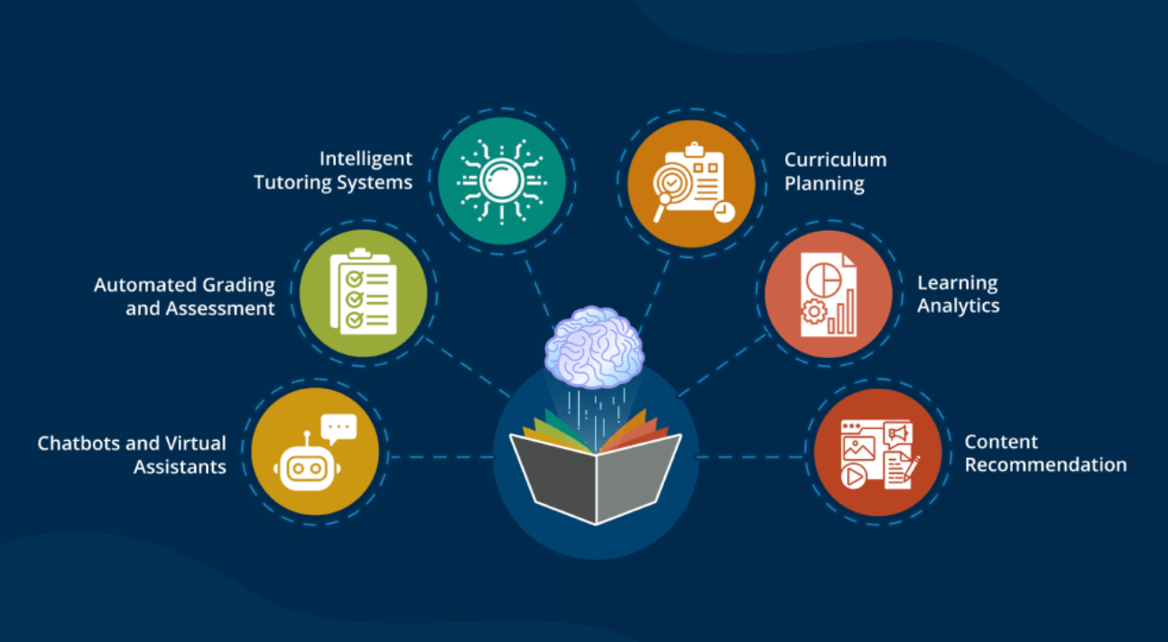
Artificial Intelligence Defined

Slide 11


WHAT IS ARTIFICIAL INTELLIGENCE IN MOODLE?
AI in Moodle refers to tools like ML, LLMs, Generative AI
AI is integrated through plugins offering AI functionalities
https://www.youtube.com/watch?v=pfpK7SJTPks
Notes:
Example: Course Assistant summarising course information

Slide 12
Artificial Intelligence in Moodle 4.5

Slide 13
ARTIFICAIL INTELLIGENCE IN MOODLE 4.5
Provides seamless integration with AI providers via plugins
AI enhances LMS experiences with structured AI interactions
Simplifies AI interactions for educators and learners
Notes:
AI applications in the education field include enabling the preparation of content, assignments, automated grading, and assistance to students.

Slide 14
Key Components of AI Sub-system in Moodle

Slide 15

KEY COMPONENTS OF AI SUB-SYSTEM IN MOODLE
Placements: User Interaction with AI
Actions: AI Functionalities
Providers: AI Integration
Subsystem Manager: AI Processing Control
Notes:
UI components enabling AI interaction
Examples: Text generation, image generation, course summarisation
Ensures consistent user experience across AI providers
How AI Interactions Work in Moodle
User triggers AI-powered action (e.g., text generation)
Placement sends request to AI subsystem
Subsystem Manager routes request to appropriate Provider
Provider processes request and returns AI-generated response
Response is displayed to the user
ACTIONS
Define tasks AI can perform
Examples: Generate text, generate image, summarise text
Have no UI but work through Moodle’s AI system
PROVIDERS
Interface between Moodle and external AI providers
Converts user requests into AI-compatible format
Example: Connecting Moodle to OpenAI or Google AI models
Subsystem Manager
Routes AI requests between Placements and Providers
Manages provider prioritisation and request handling
Ensures correct processing and storage of AI responses

Slide 16
Benefits of Artificial Intelligence in Moodle

Slide 17
BENEFITS OF ARTIFICIAL INTELLIGENCE IN MOODLE
Reduces educator workload through automation
Seamless integration with external AI models
Provides a structured, user-friendly AI experience
Personalised learning with AI-powered assistance
Notes:
Example: Course Assistant summarising course information

Slide 18
DEMONSTRATION
Demonstration

Slide 19

DEMONSTRATION
Demonstration

